Slide 1

E-Commerce Sales & Profitability Analysis
Name: Ayush Kumar
Batch Cohort: Batch-03
Student ID: INST26DA030238
Internship Domain: Data Analytics

Slide 2
Project Overview
An end-to-end analytical assessment of an e-commerce retail dataset of 9,994 transactions over four years of operation (from 2014 to 2017) is carried out in this project. The data analytics pipeline involves the entire life cycle of data—right from the programmatic data ingestion, auditing, and cleaning using Python, through exploratory data analysis and statistical modeling, and finally into the construction of a Power BI dashboard supported by GitHub documentation.
Even though the business made a revenue of over $2.30 million in gross revenue through 5,009 orders, net profit margins are tight, sitting at just 12.47% or $286.40 thousand net profit. The key purpose of this project is to determine the underlying causes behind the compressed margins, such as uncontrolled promotions, shipping costs, and non-profitable categories.

Slide 3
Problem Statement
This project focuses on solving a key operational problem that despite the business being able to make over $2.30M in gross revenues from 5,009 unique orders, its overall net profit margins are constrained to 12.47% or $286.40K net profit. Revenue growth is not enough to drive sustainable financial growth due to significant margin erosion in certain product lines, promotion channels, and regions.
Uncontrolled Promotional Discounts: Discounts greater than established baseline (especially those ≥30%) lead to severe margin erosion where high discounts mean net losses of up to -180.03%.
Underperforming Product Sub-Categories: Inefficiencies in pricing strategies combined with high shipping costs create an environment where certain sub-categories, such as Tables ($17.73K loss) and Bookcases ($3.47 K loss), generate net losses thus offsetting the profits from the core sub-categories like Technology.
Issues in Certain Regions: There are significant discrepancies in margin performance in different regions. Whereas the West region demonstrates excellent performance with profit margin of 14.94%, the Central Region lags behind with 7.92%.

Slide 4
Dataset Overview
Data Set Details: The basis for the analysis of this study is the E-Commerce Retail Dataset (cleaned_sales_data.csv). The data set was audited, cleaned, and engineered in terms of features to ensure that the analysis process is reliable. It consists of 9,994 orders which represent a historical transactional record for a period of four years, from 2014 through 2017. The total number of 24 cleaned and engineered features is presented.
Time Related Features: Order Date and Ship Date (in datetime format), as well as Order Year, Order Month, and Ship Duration (Days).
Geography/Customer-related Features: Regional Classification with multiple levels of classification by Region (West, East, Central, South), State, and City and Customer Segment (Consumer, Corporate, Home Office).
Product Taxonomy: Hierarchy-based feature representing product classification within 3 main Categories (Technology, Furniture, Office Supplies) and 17 Sub-categories (such as Copiers, Phones, Tables, and Binders).
Numeric Features: Transaction level numeric features representing transactional sales amount, Discount rate (0% to 80%), Quantity and Profit.

Slide 5
Tool used
Data Processing & EDA: Python (pandas, numpy, matplotlib, seaborn)
Business Intelligence: Power BI Desktop
Version Control: Git, GitHub

Slide 6
Target End Users for the Project
Executive Leadership & C-Suite: Chief Executive Officers (CEOs), Chief Financial Officers (CFOs), and Vice Presidents of Sales who require high-level visibility into company revenue ($2.30M), overall profit ($286.40K), and aggregate margins (12.47%) to make strategic corporate decisions.
Sales & Pricing Managers: Commercial teams responsible for setting promotional policies, managing discount structures (enforcing caps at 15%–20%), and evaluating customer segment performance (Consumer, Corporate, Home Office).
Product Category Managers: Inventory and merchandising leads who oversee specific categories (Technology, Furniture, Office Supplies) and need to address underperforming or loss-making sub-categories like Tables and Bookcases.
Regional Sales Directors & Territory Managers: Field leaders across the West, East, Central, and South regions who monitor localized sales trends, optimize regional marketing, and fix regional profitability bottlenecks (such as the Central region lag).
Supply Chain & Operations Teams: Fulfillment managers analyzing shipping durations (averaging 3.96 days) and logistics costs to improve overall operational efficiency.

Slide 7
Data Cleaning Process
Data Sanitization & Integrity Auditing
The initial data pipeline focused on ensuring data cleanliness and structural integrity prior to downstream analytical modeling:
Encoding Resolution & Missing Value Audit: Standardized file decoding during ingestion (handling utf-8 / latin1 variations) and verified zero null entries across all 9,994 transaction rows.
Uniqueness Verification: Performed a record-level audit across primary transaction keys, confirming 0 duplicate rows within the dataset.
Feature Engineering & Transformation
To support granular time-series analysis and logistics performance benchmarking, several key attributes were transformed and derived:
DateTime Parsing: Converted string-based Order Date and Ship Date fields into standardized datetime64[ns] object types to enable temporal operations.
Seasonality Tracking: Extracted explicit Order Year and Order Month dimensions to evaluate annual growth trends and track recurring Q4 sales spikes.
Logistics Performance Metric: Calculated Ship Duration (Days) by measuring the elapsed time between order placement and fulfillment (Ship Date − Order Date), establishing an average fulfillment benchmark of 3.96 days across all shipping modes.

Slide 8
Exploratory Data Analysis (EDA)
Statistical Distributions Some important behavioral insights discovered during the process of exploratory data analysis in sales, discounts, and profit margins on $9,994 transactions are:
Revenue-Profit Correlation (r = 0.48): There is a moderately strong positive relationship between the total Sales and Profit. Although high-priced items contribute towards greater revenues, higher volume of sales do not guarantee higher profits because of the different cost structures and discounts.
Discount-Profits Correlation (r = -0.22): There is a very strong negative relationship between the discount rates and the profits. The more percentage of discount offered, the faster the profits are reduced.
Profit Outliers Analysis using (IQR): The use of IQR method to identify outliers (1.5 x IQR) identified 1,881 profit outliers. The highly negative outliers are almost exclusively linked with high promotional discounts (> 30%), while the positive outliers are related to high-profit margin Technology category with zero discounts (Copiers).

Slide 9
Visualizations Overview
The project comprises five key statistical and business-related charts analyzing margins, discounting practices, and sales distribution:
Correlation Heatmap (correlation_heatmap.png): Feature matrix revealing a positive correlation between Sales and Profit (r = 0.48) and a strong negative correlation between Discount and Profit (r = -0.22).
Category Performance Detailed Chart (category_performance_detailed.png): Two-axis chart showing that Technology is the leader in terms of net profit (17.39% margin / $145.45K), whereas Furniture experiences significant margin pressure (2.49% margin $18.45 k profit).
Monthly Sales & Profit Trend Chart (sales_profit_trend.png): Time series multi-line chart showing yearly revenue increase and seasonal Q4 spikes.
Individual Segmentation Distribution Chart (segment_distribution_donut.png): Donut chart illustrating that Consumer dominates in terms of sales (50.56% share / $1.16M, whereas Home Office shows the best profit margin (14.03%).
Discount & Profitability Correlation (discount_profit_correlation.png): Scatter plot showing a drop to negative margins after 20% discounts (dropping from -10.05% margin at 30%

Slide 10
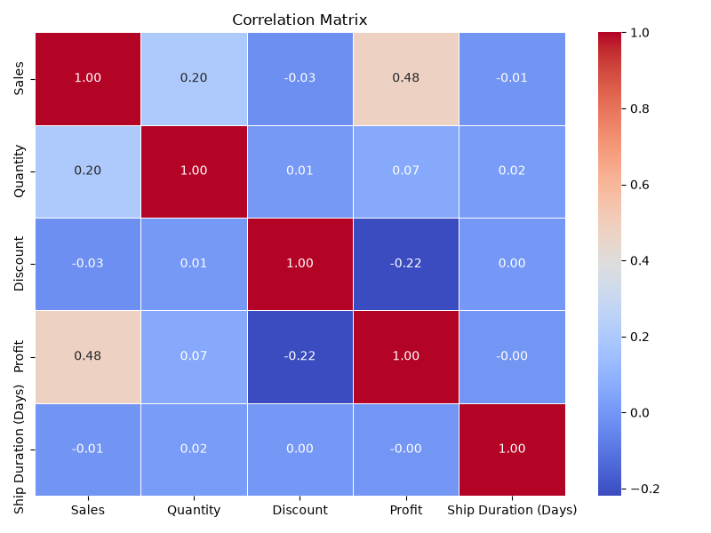
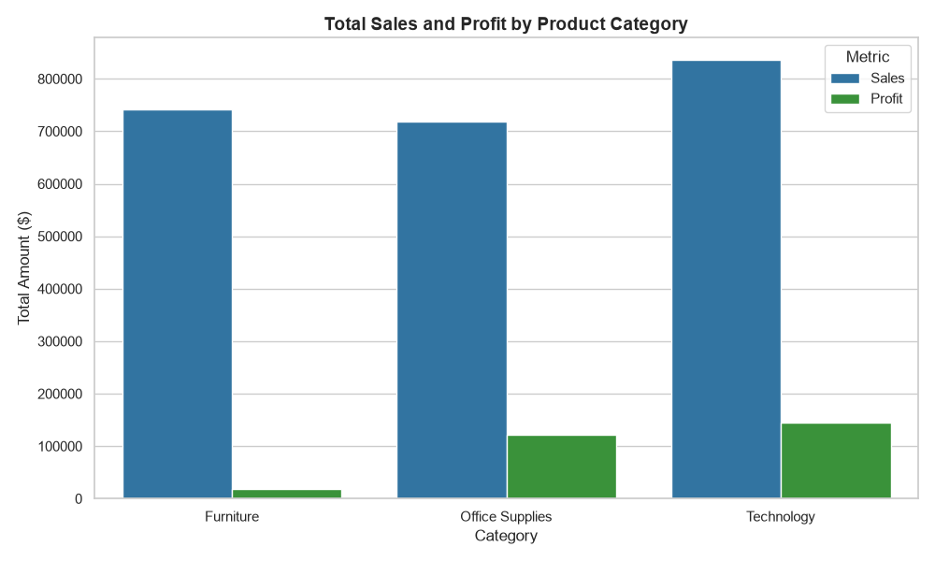
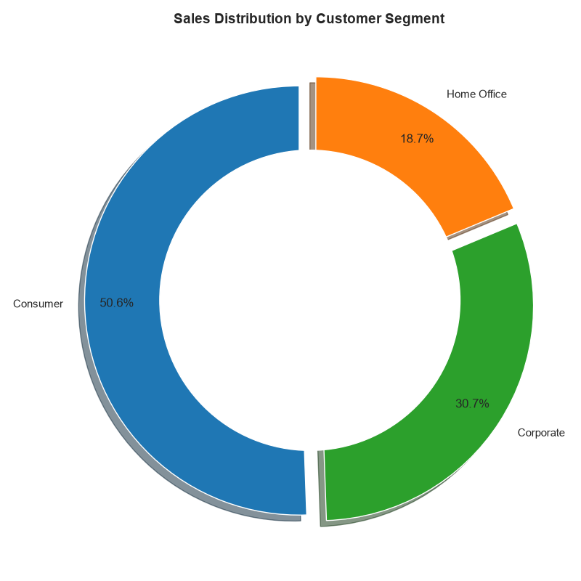
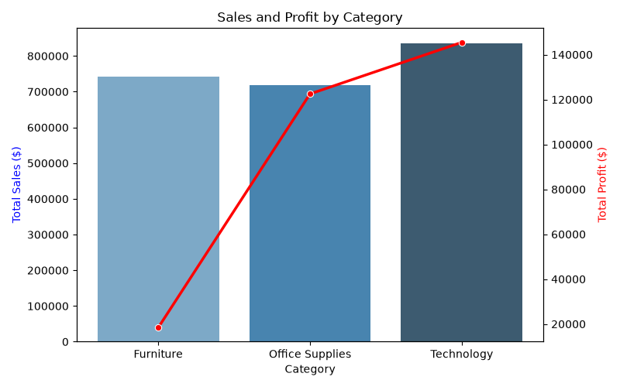
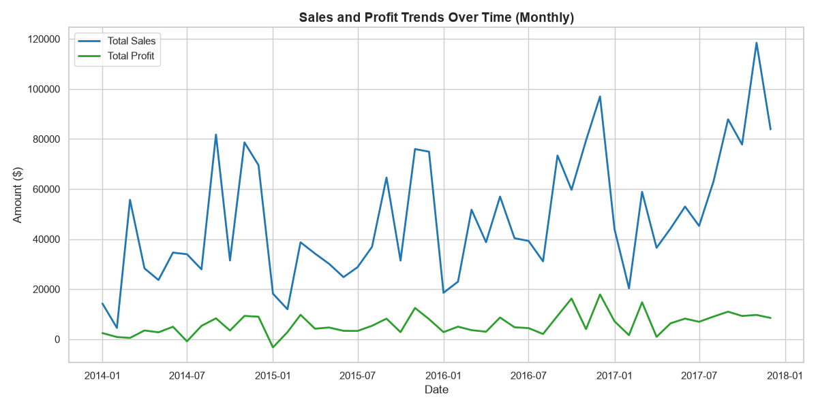
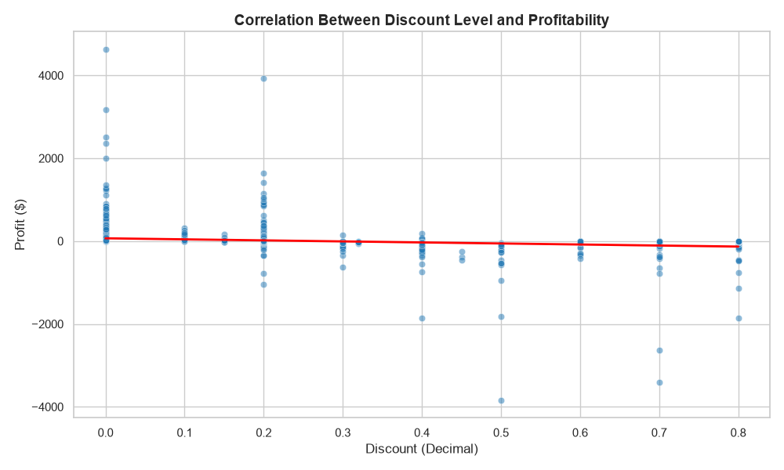
Category Performance & Analysis
Correlation Heatmap
Customer Segmentation
Category Performance & Analysis
Time-Series & Sales Trends
Discount & Profitability Analysis

Slide 11
Power BI Dashboard
The interactive Power BI dashboard serves as a central reporting solution for executive decision-making and operational performance tracking.
4 Top Executive KPI Cards: Positioned across the top header banner to provide an immediate snapshot of core performance metrics:
Total Sales: $2.30M
Total Profit: $286.40K
Profit Margin: 12.47%
Total Orders: 5,009
Visual Canvas (4 Core Charts):
Category Performance (Clustered Column Chart): Compares total sales against net profit across product categories to highlight margin divergence.
Monthly Sales & Profit Trend (Line Chart): Tracks monthly revenue trajectories and profit trends across 2014–2017 to monitor seasonal demand spikes.

Slide 12
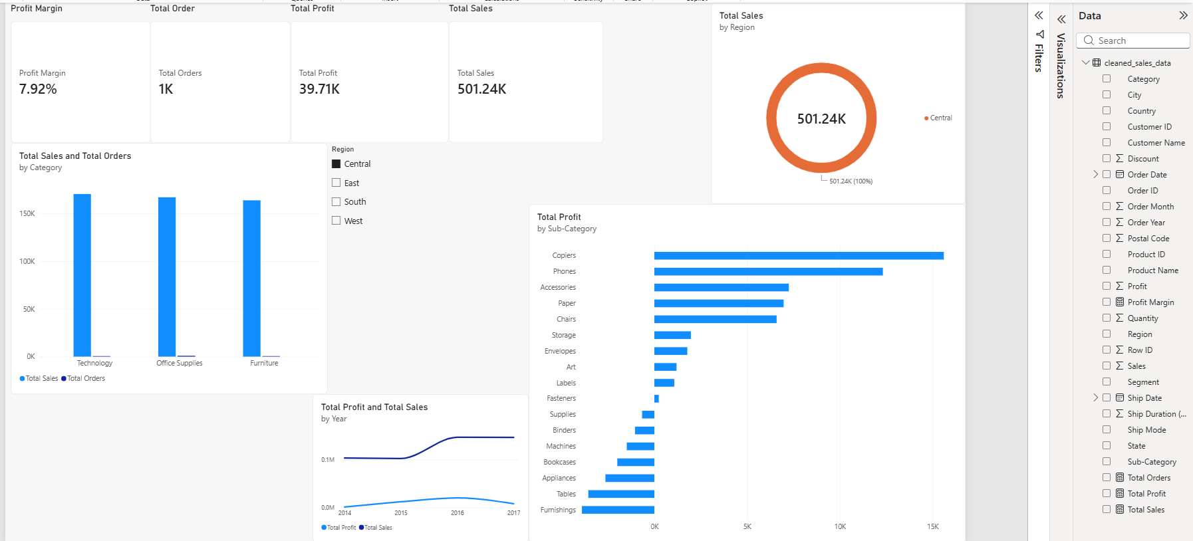
Power BI Dashboard
Regional Sales Distribution (Donut Chart): Breaks down total revenue proportion across the West, East, Central, and South regions.
Profitability by Sub-Category (Horizontal Bar Chart): Displays net profit and losses across all 17 sub-categories, pinpointing underperforming lines like Tables and Bookcases.
Dynamic Interactivity & Slicers: Equipped with interactive Region and Customer Segment filter slicers, allowing stakeholders to dynamically slice all canvas visual charts and KPI metrics in real time.

Slide 13
Key Business Insights
Promotional Discount Risk: Promotional discounting is the single largest driver of profit erosion across business operations. Sales sold at full price (0% discount) deliver a strong 29.51% profit margin, but profitability declines rapidly as discounts increase. Transactions discounted at 30% or higher consistently operate at a net loss, escalating to an extreme negative margin of -180.03% on items discounted at 80%.
Product Category Divergence: High overall sales figures conceal major structural profitability imbalances across core product categories. Technology serves as the primary growth engine, generating 50.8% of total company profit ($145.45K) at a healthy 17.39% margin. In contrast, Furniture suffers severe margin compression—delivering a meager 2.49% profit margin ($18.45K net profit on $742K in sales) due to heavy loss-making sub-categories like Tables (-$17.73K) and Bookcases (-$3.47K).
Customer Segment Variation: Performance metrics vary significantly across buyer groups, highlighting a trade-off between order volume and profitability. The Consumer segment drives top-line revenue—generating 50.6% of total sales ($1.16M)—but operates at a lower profit margin of 11.55%. Conversely, the Home Office segment yields the company's highest profit margin at 14.03%, demonstrating greater margin resilience despite smaller overall transaction volumes.

Slide 14
Strategic Business Recommendations
Recommendation 1: Enforce Strict Discount Thresholds
Establish Executive Discount Caps: Cap baseline promotional discounts at 15%–20% across all standard sales channels to preserve healthy unit-level profit margins.
Eliminate High-Loss Discounting: Immediately restrict discounts above 30% on profit-draining sub-categories such as Tables, Bookcases, and Binders, which are currently driving negative margins.
Recommendation 2: Portfolio & Regional Restructuring
Product Portfolio Optimization: Adjust baseline retail pricing, optimize shipping fee structures, or renegotiate supplier procurement costs for loss-making sub-categories (Tables at -$17.73K net loss and Bookcases at -$3.47K net loss).
Targeted Marketing Allocation: Reallocate promotional and advertising budgets toward high-margin Technology products (17.39% margin) and the Home Office customer segment (14.03% margin) to maximize return on sales.
Regional Performance Alignment: Restructure promotional rules and sales strategies in the Central Region to resolve its profit margin lag (7.92%) and align operations closer to the West Region's industry benchmark of 14.94%.

Slide 15
Project Conclusion
The analytical evaluation confirms that top-line revenue volume alone does not translate into sustainable profitability without strict operational margin controls. While the organization successfully generated $2.30M in gross sales across 5,009 transactions, unmonitored promotional discounting, high shipping overheads, and underperforming product lines caused significant net margin erosion.
Execution Roadmap: Enforce strict promotional discount caps at 15%–20%, eliminate high-loss discount thresholds exceeding 30%, and reallocate promotional budgets toward high-margin growth drivers like the Technology category and Home Office customer segment.
Expected Financial & Operational Impact: Implementing these targeted margin controls will eliminate systemic net losses in sub-categories like Tables and Bookcases, resolve regional profitability bottlenecks in the Central region, and elevate overall corporate net profit margins from 12.47% to over 18%.

Slide 16
GitHub Link

